Slide 1
Safety Devices
Dr/ Mohamed Zakaria
Group: 29

Slide 2
Safety Devices
Protection devices presence in circuit is must
Protection devices in continuous development
Many types where made

Slide 3
Safety Devices Types
Divide into 2 type
Over Current Devices
Fuses
Circuit Breaker
Residual Current Devices

Slide 4
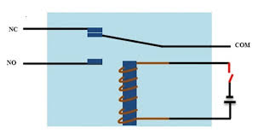
Theory of Operation
Fuses
Circuit Breaker
Residual Current Devices

Slide 5
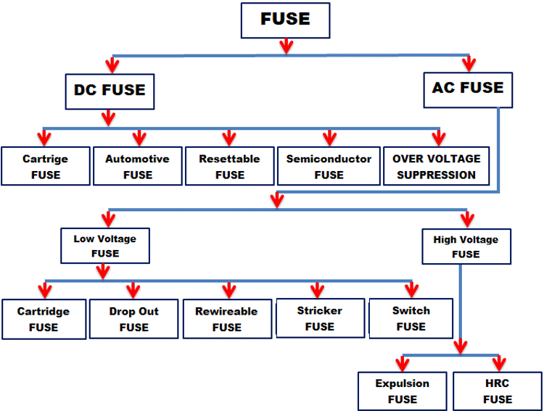
Fuses
Types

Slide 6
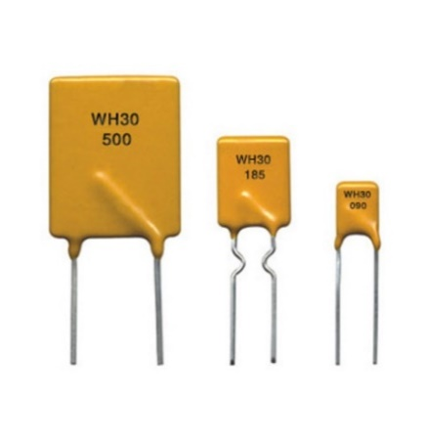
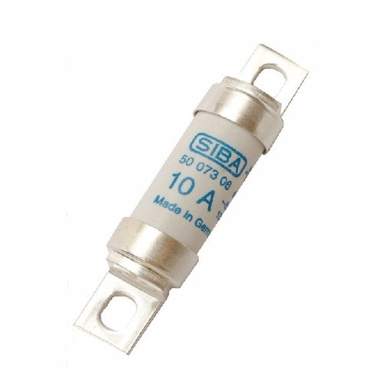
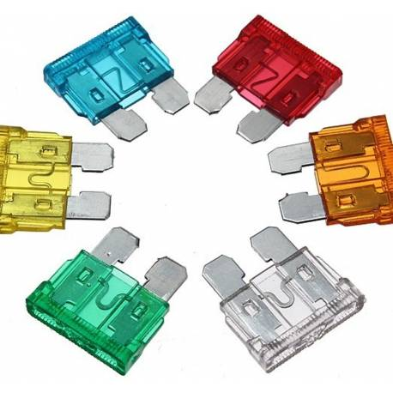
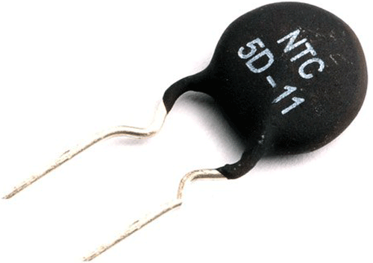
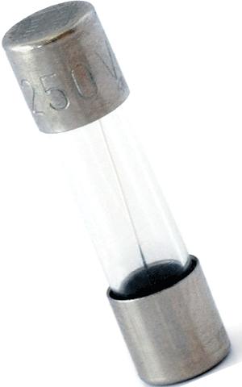
DC Fuses
Cartridge fuses
Automotive fuses
Resettable/Poly fuses
Semiconductor fuses
Overvoltage suppression

Slide 7
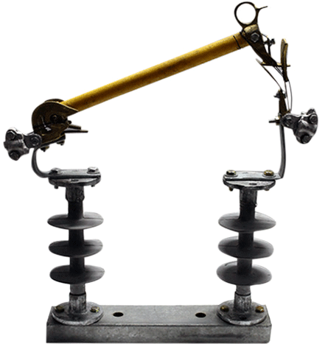
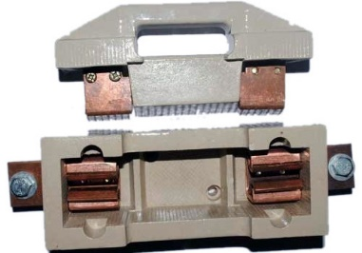
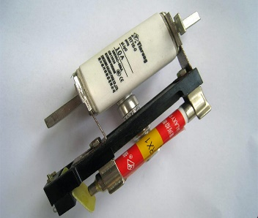
AC Fuses
Low Voltage Fuses
Cartridge fuses
Drop out fuses
Rewireable fuses
Striker fuse
Switch fuse

Slide 8
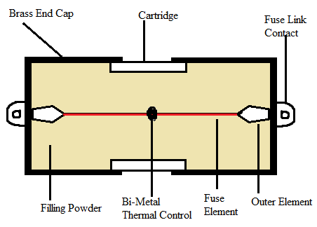
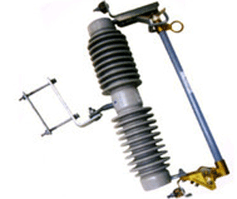
AC Fuses
High Voltage Fuses
HRC fuses
Expulsion type HRC fuses

Slide 9
Fuses
Features
Current Rating
I square T Value
Voltage Rating
Operating Temperature

Slide 10
Applications
Electrical wiring at home
Appliances like AC, Refrigerator, TV, Washing machine etc.
Laptops
Mobile Chargers
Automobiles (Cars, Trucks, Buses, etc).

Slide 11
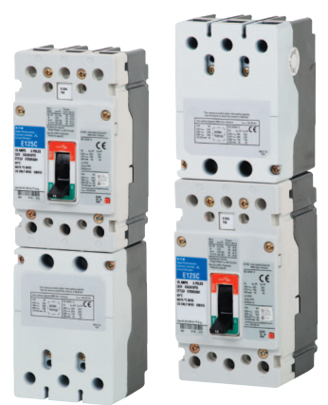
Circuit Breakers
Types
Low Voltage Circuit Breakers
Molded Case Circuit Breaker (MCCB)
Air Circuit Breaker (ACB)
Miniature Circuit Breaker (MCB)
Motor Protection Circuit Breaker (MPCB)

Slide 12
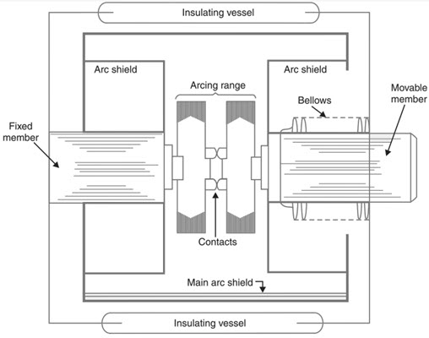
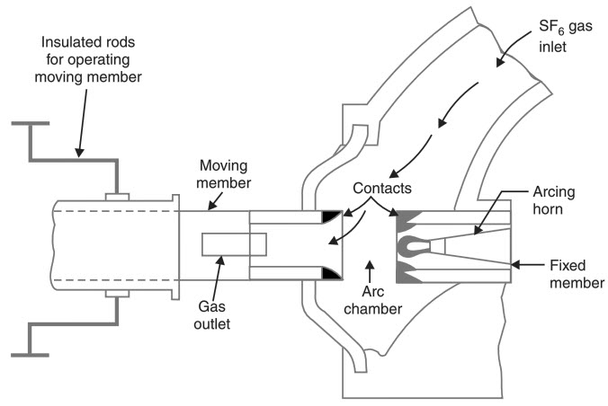
Circuit Breakers
Medium Voltage Circuit Breakers
Vacuum Circuit Breaker (VCB)
SF6 Circuit Breaker

Slide 13
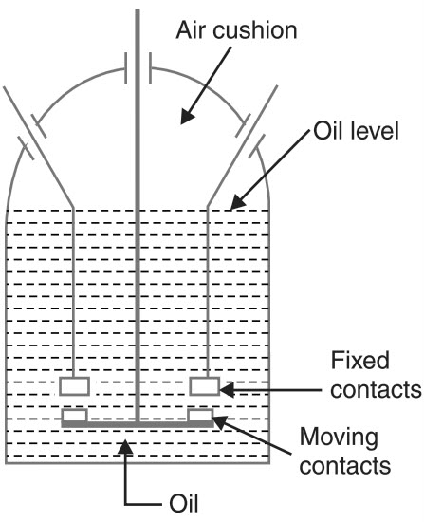
Circuit Breakers
High Voltage Circuit Breakers
Vacuum Circuit Breaker (VCB)
SF6 Circuit Breaker
Oil Circuit Breaker

Slide 14
Circuit Breaker
Applications
Criteria of choosing
Calculations

Slide 15
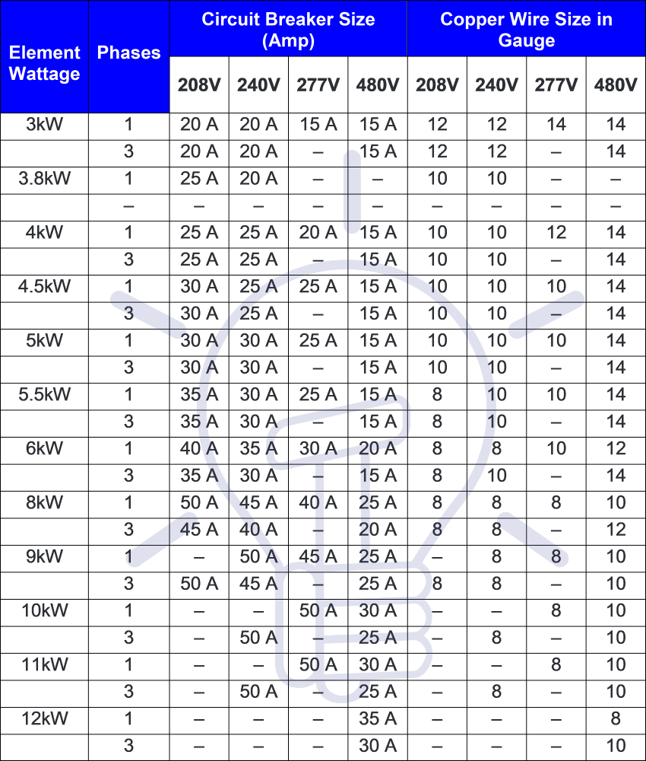
Circuit Breaker
Selection Tables
Manufacturers
Life span

Slide 16
Residual Current Devices
Types
RCCB (Residual current circuit breaker)
RCBO (Residual current breaker with overload)
ELCB (Earth leak circuit breaker)

Slide 17
Residual Current Devices
Sensitivity
High sensitivity: 5, 10, 30 mA (for direct-contact or life injury protection).
Medium sensitivity: 100, 300, 500, 1000 mA (for fire protection).
Low sensitivity: 3, 10, 30 A (typically for protection of machine).

Slide 18
Residual Current Devices
Limitations
Applications
Installation Types

